Slide 1
EEE 350: Random Signal Analysis

Slide 2
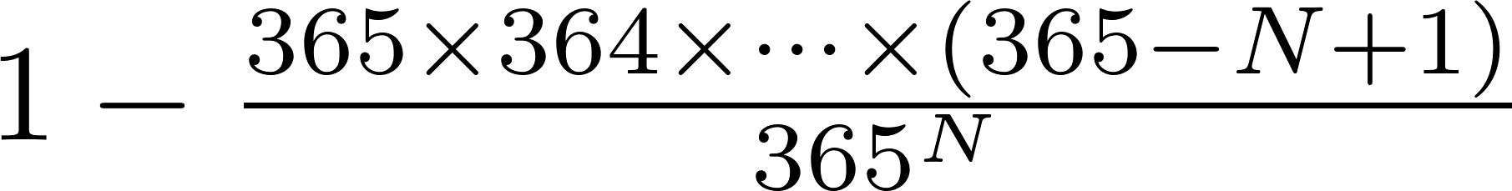
Example: Birthday Problem
Birthday problem: Given N people in a room, what is the probability that 2 or more people will have the same birthday?
1 – “Probability that all N people have different bdays”

Slide 3
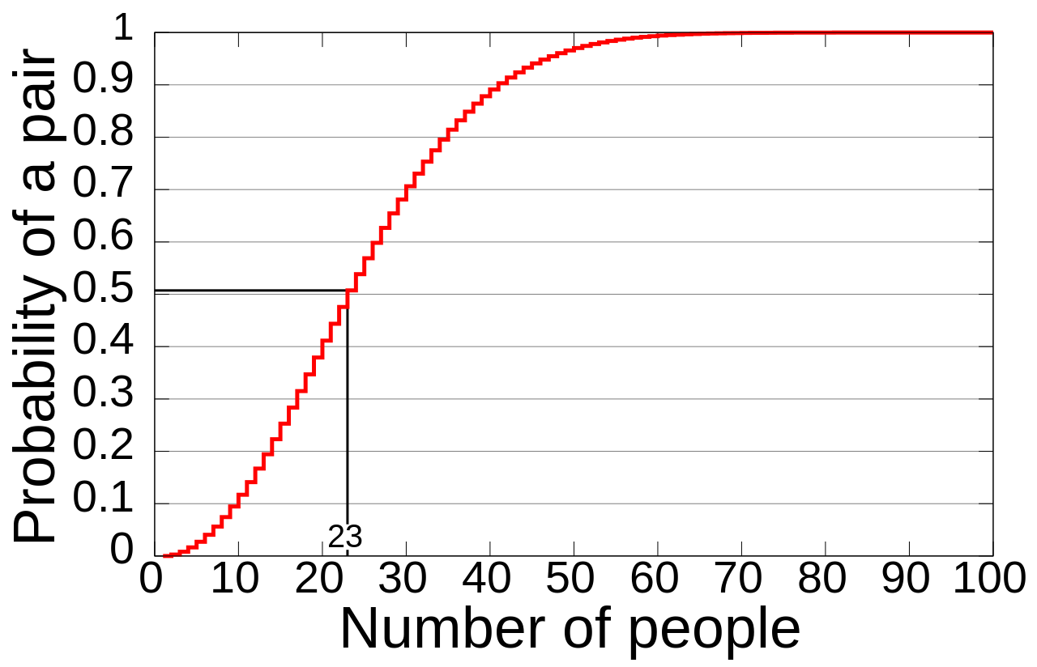
Example: Birthday Problem
http://en.wikipedia.org/wiki/Birthday_problem

Slide 4
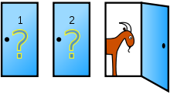
Example: Monty Hall Problem
Game show setting; 3 doors: 2 Goats, 1 Car
You chose one door. Host opens one of the doors that you didn’t pick and has a goat.
You have the option to stick with your choice or switch
What should you do??
http://en.wikipedia.org/wiki/Monty_Hall_problem

Slide 5
Example: Monty Hall Problem
Assume you are committed to switching.
If you had selected a C initially, then switching will lead to a G (why?)
If you had selected a G initially, the switching will lead to a C.
Since selecting a G initially is more likely (2/3 prob), then switching is the best policy
Conclusion: Switching is twice more likely to win you a car than sticking with your original choice!
The extra info that the host provides is useful!

Slide 6


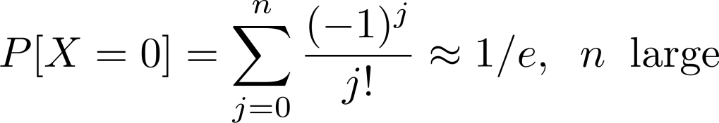

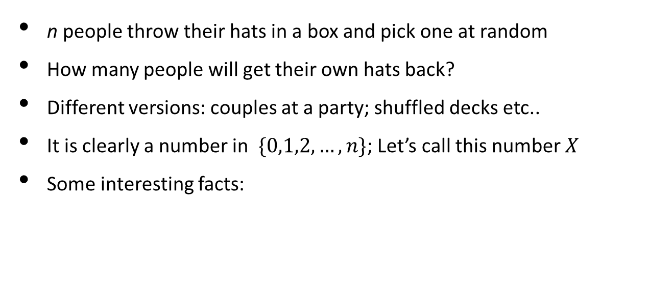
Example: The Hat Problem
n people throw their hats in a box and pick one at random
How many people will get their own hats back?
Different versions: couples at a party; shuffled decks etc..
It is clearly a number in $\{0,1,2, …, n\}$; Let’s call this number $X$
Some interesting facts:

Slide 7
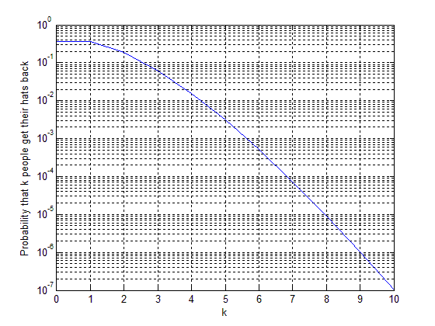
Example: The Hat Problem

Slide 8
Acknowledgements and Citations
Parts of these slides are adapted from the following resources:
Power Point Lecture Slides for the Textbook http://bcs.wiley.com/hebcs/Books?action=index&bcsId=8676&itemId=1118324560
John Tsitsiklis. 6.041 Probabilistic Systems Analysis and Applied Probability, Fall 2010. (Massachusetts Institute of Technology: MIT OpenCourseWare),http://ocw.mit.edu (Accessed 13 Apr, 2015). License: Creative Commons BY-NC-SA

